Slide 1
40 Year Overview of vegetation sampling on Three Mile Island: past, present and future
Prepared by Marge Holland, Professor Emerita, Biology Department, University of Mississippi,
In collaboration with William Clapham [“Bat”], USDA-Agricultural Research Service, Research Scientist, retired, and
Jay Maciejowski, Forester, Vermont Agency of Natural Resources, retired

Slide 2
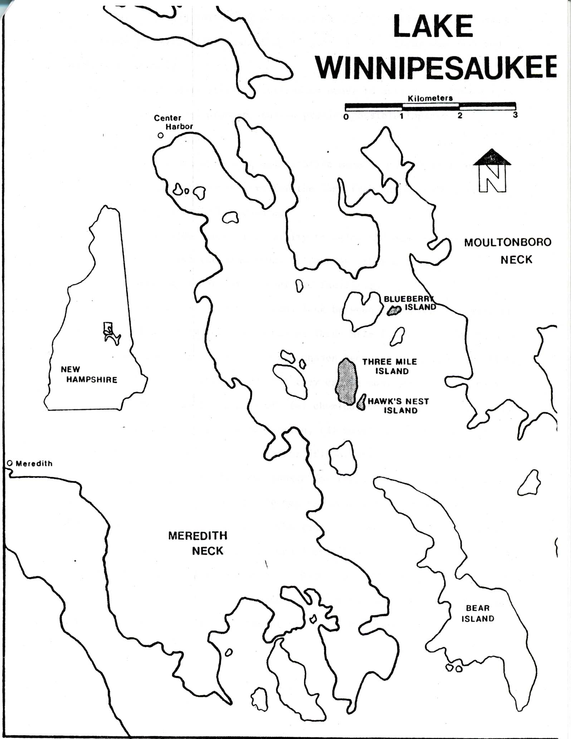
Lake Winnipesaukee located in central New Hampshire: TMI flora investigated by Boston-based botanists in 1901

Slide 3
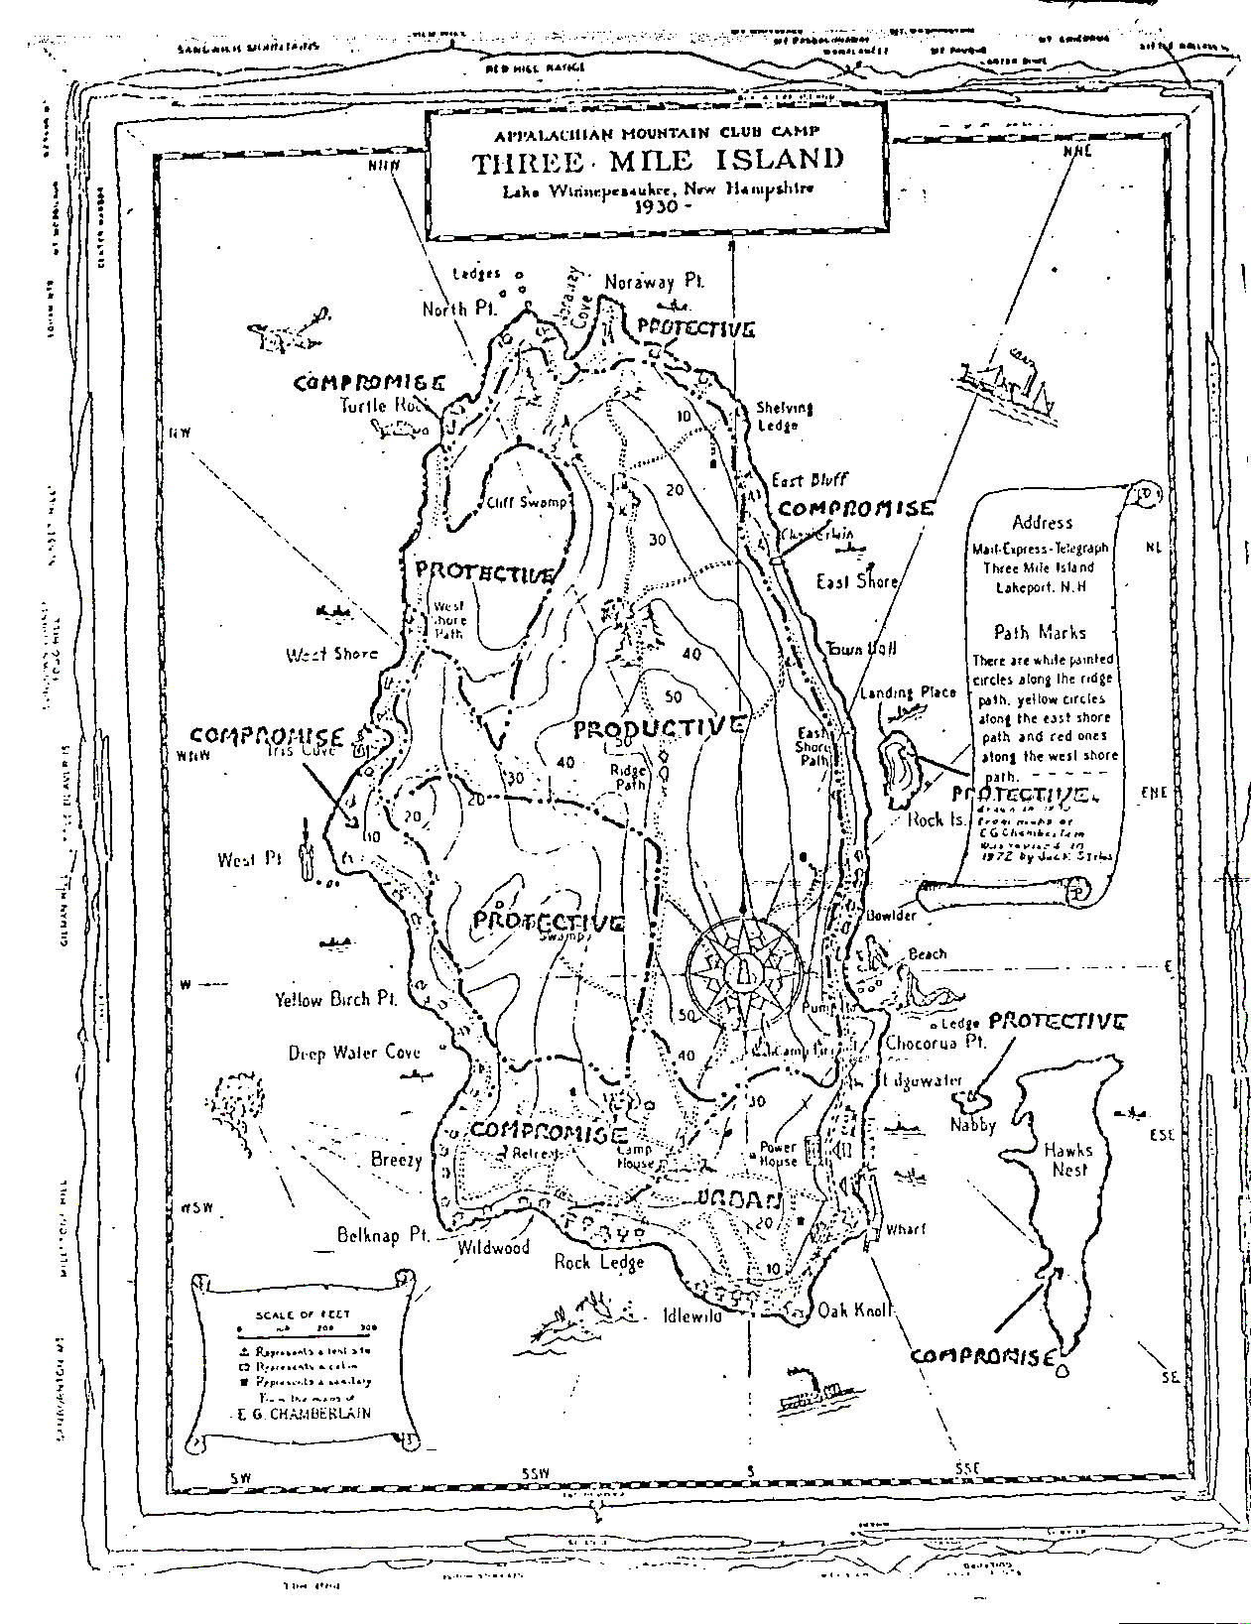
Three Mile Island Zoning Map
Adopted by TMI Camp Committee in mid-1970’s

Slide 4
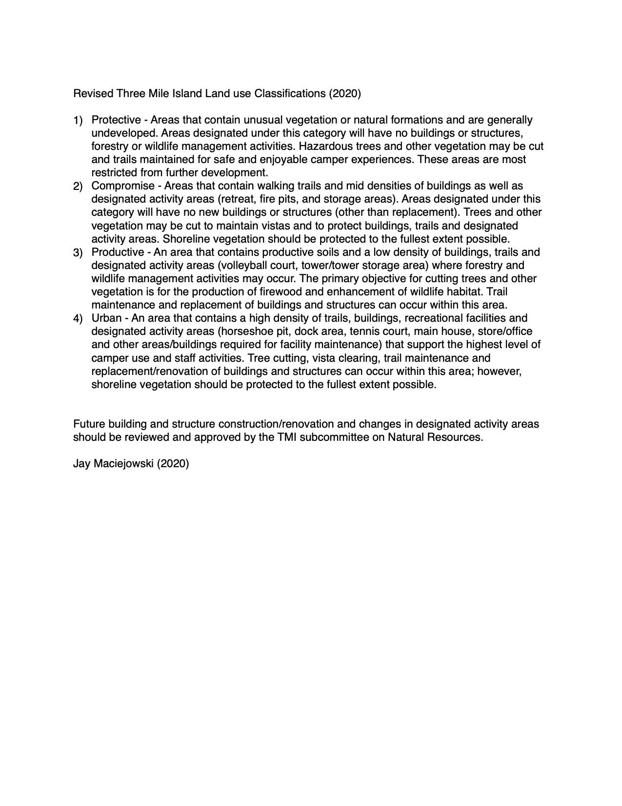
TMI Zoning Classes and Acceptable Uses
LAND USE ZONING PLAN
(Adapted by Jay, Marge, and Paul Ritch from E.P. Odum (1969), and Adopted by Three Mile Island Camp Committee)
ZONE PRESENT USE ALLOWED FUTURE USE
Protective areas which contain unusual most restricted from future
vegetation or natural development and will
formations and are generally remain in a natural state
undeveloped
Compromise land areas containing a small no new buildings is
density of buildings and encouraged; replacement
located along areas of building, trail maintenance,
shoreline sensitive from an and cutting of vegetation
aesthetic point of view to maintain vistas and
protect buildings is allowed
Productive areas designated for forestry manage area for harvest
and wildlife habitat of firewood
improvement cuttings
Urban existing built-up areas and construction is allowed,
areas of heavy use but plans for building are
submitted to Natural Resources Advisory Committee for approval

Slide 5
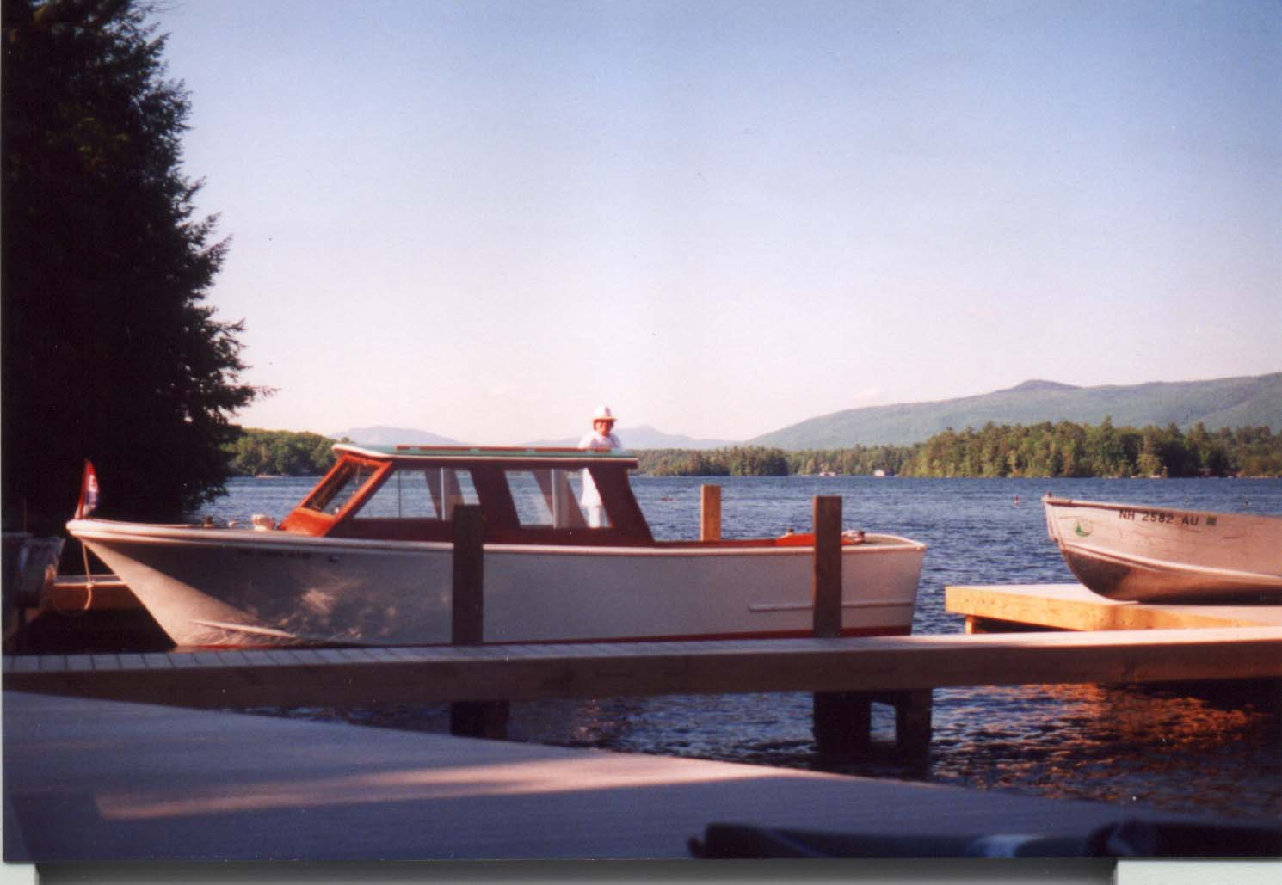
Example from Urban Zone: the TMI dock is a good example of an area designated as part of the “Urban zone.” Urban areas are those that receive heavy use by campers and staff

Slide 6
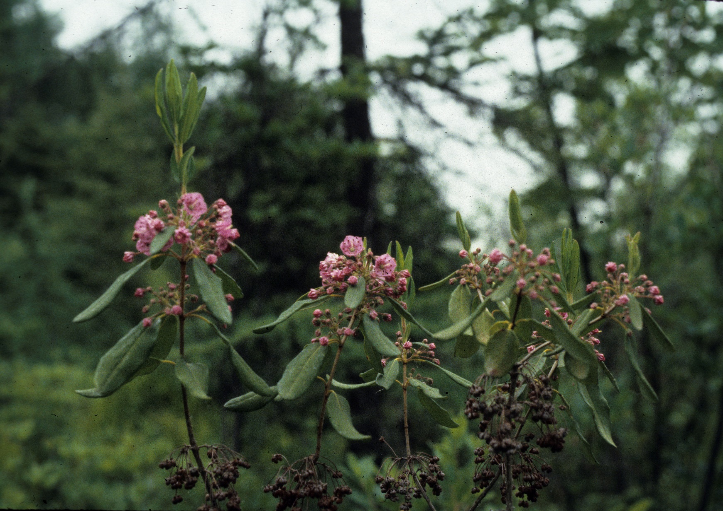
Sheep Laurel: blooming at Noraway Point in Protective Zone

Slide 7
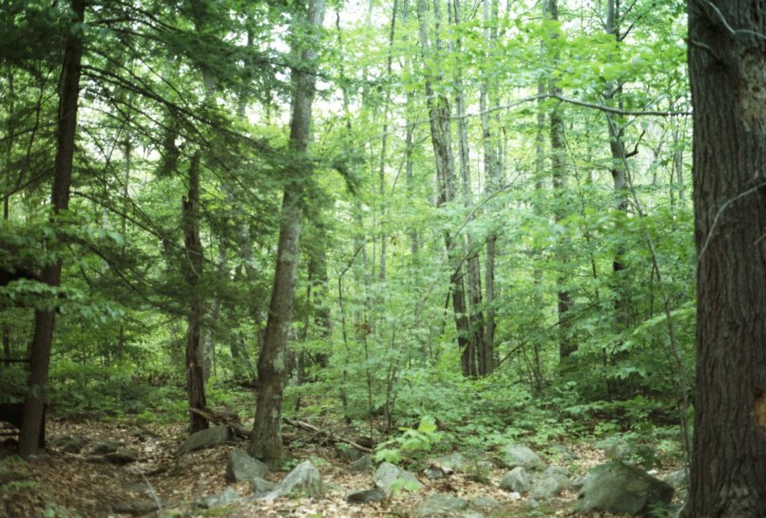
Example from Productive Zone near the Ridge Path

Slide 8
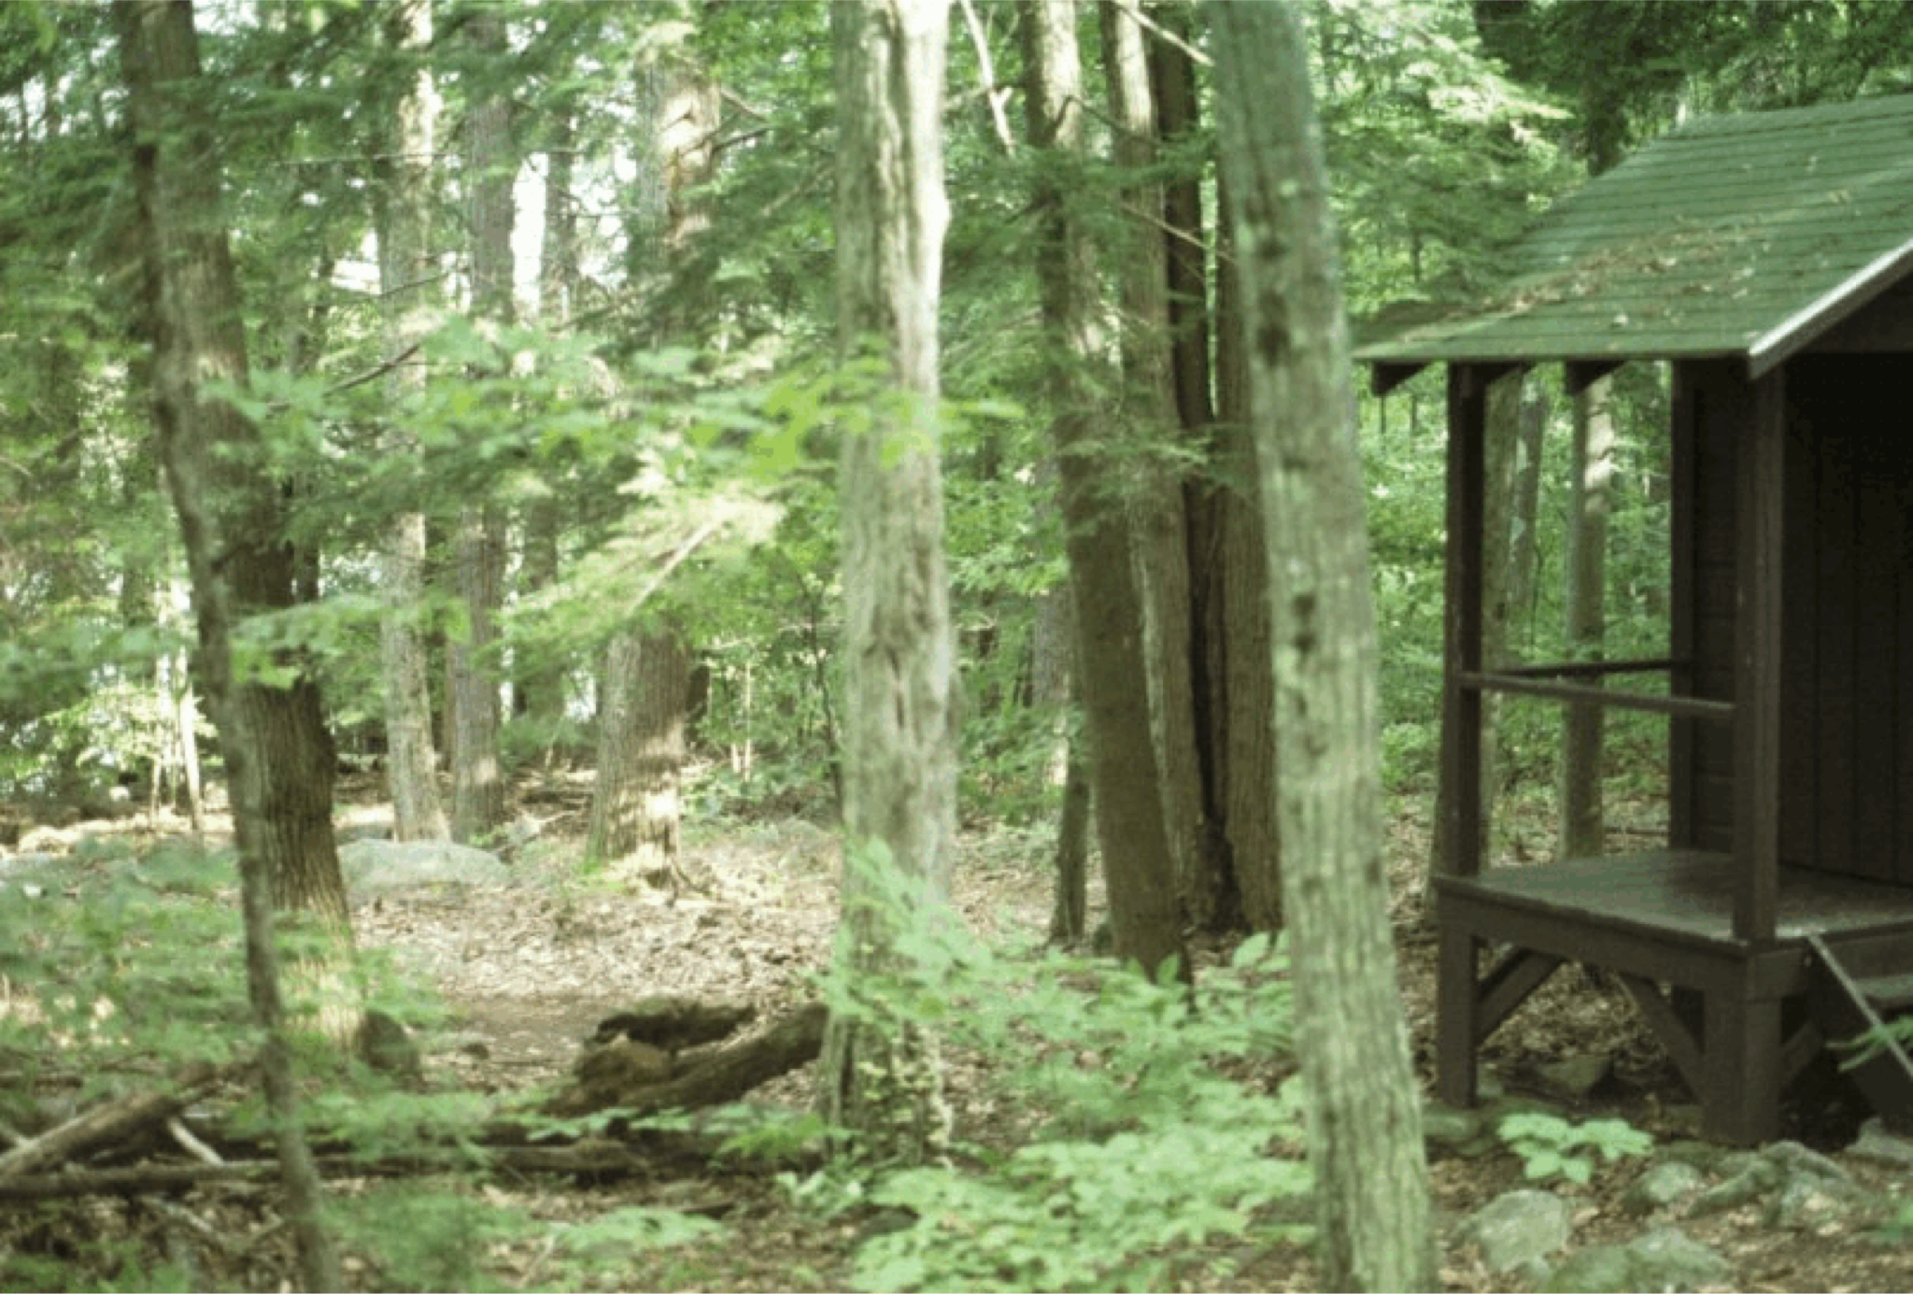
The Compromise Zone includes areas around cabins

Slide 9
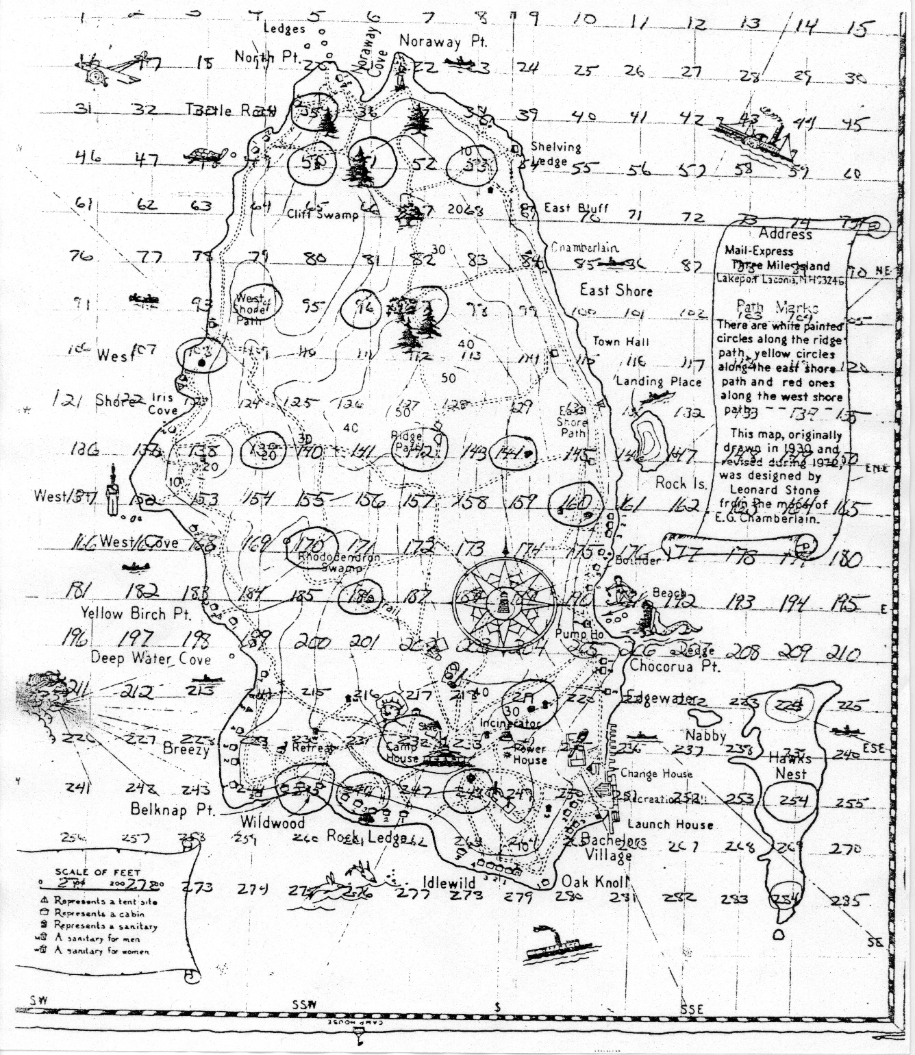
AMC headquarters staff asked how TMI folks would know the zoning was working?: In 1978, Bat, Jay and Marge randomly chose 25 plots distributed across Three Mile, Hawk’s Nest, and Blueberry Islands. Circled numbers represent the chosen plots on TMI and Hawk’s Nest.

Slide 10
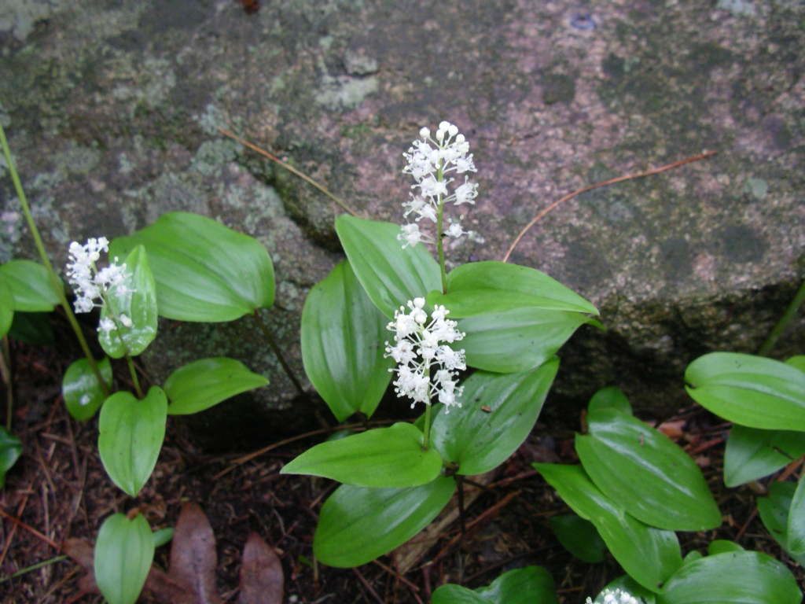
False Lily-of-the-Valley or Canada Mayflower, which is common along Ridge Path

Slide 11
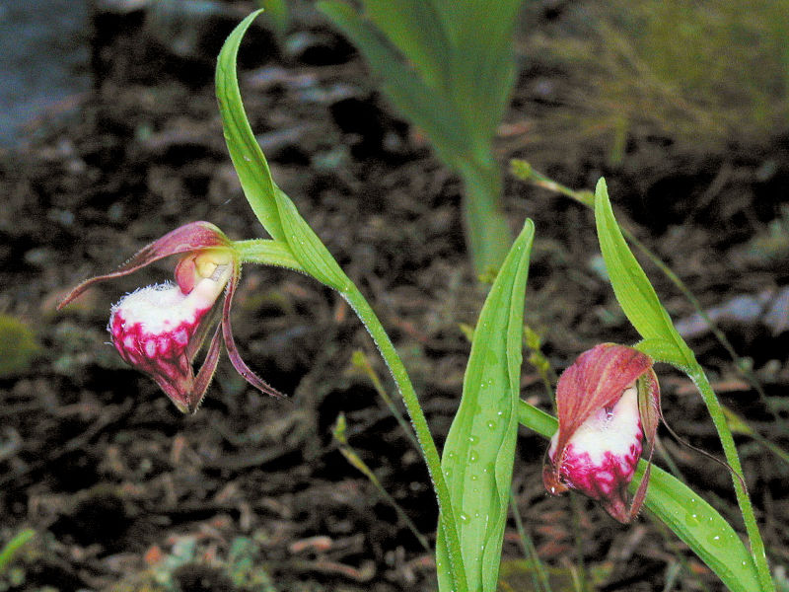
Ram’s Head Lady Slipper: a rare species in Protective Zone

Slide 12
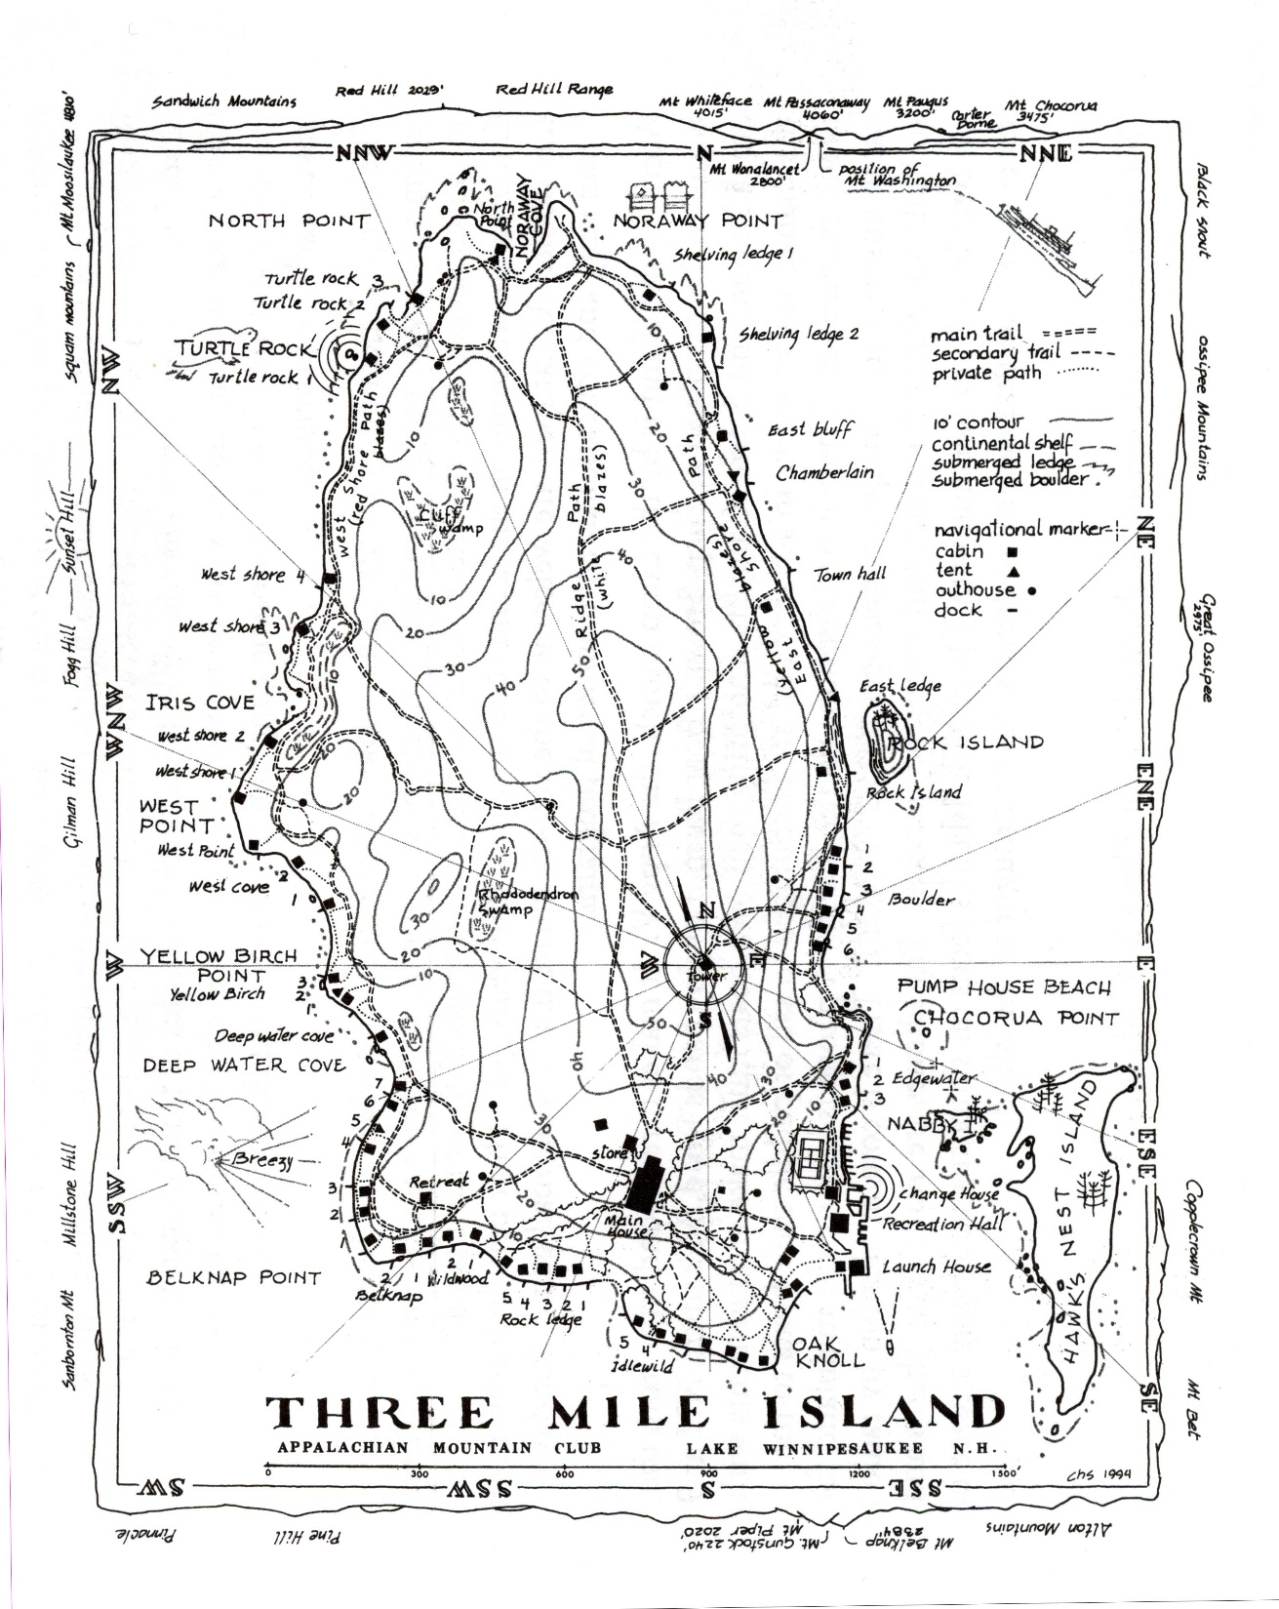
Map of TMI
Camp Committee has increased amount of area designated as “protective” after re-discovery of Ram’s Head Lady Slipper.

Slide 13
Changes in top five dominant woody species from 1978 to 2011
THREE MILE ISLAND
1978 2011
White pine * Striped maple
Red oak * Beech
Paper birch * Hemlock
Red pine * Red maple
Red maple * Red oak

Slide 14
Mean Species per Quadrat for Understory Plots

Slide 15
Effectiveness of Land Use Plan
Species diversity has increased since implementation of zoning plan
Globally, scientists believe that higher biological diversity means healthier natural areas
Most changes in the forest can be attributed to lighting strikes and other natural storms since the land use plan was implemented.

Slide 16
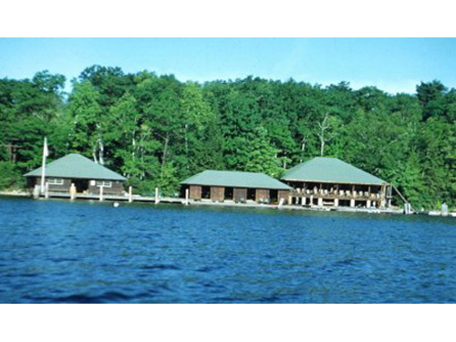
The Dock in 1961 For over 120 years AMC members have been interested in the natural history of Three Mile Island and adjacent islands. During roughly half that time, campers have enjoyed the recreational opportunities offered on 'the dock‘.

Slide 17
And Now, in summer 2021,
Dr. Diana Jolles, Assistant Professor of Plant Biology,
and Director, Plymouth State University Herbarium,
Plymouth State University, Plymouth, NH,
will lead the Three Mile Island study.

